Slide 1
CS162 Operating Systems and Systems Programming Lecture 18 File Systems
April 4th, 2016
Prof. Anthony D. Joseph
http://cs162.eecs.Berkeley.edu

Slide 2
Quick Aside: Big Projects
What is a big project?
Time/work estimation is hard
Programmers are eternal optimists (it will only take two days)!
This is why we bug you about starting the project early
Had a grad student who used to say he just needed “10 minutes” to fix something. Two hours later…
Can a project be efficiently partitioned?
Partitionable task decreases in time as you add people
But, if you require communication:
Time reaches a minimum bound
With complex interactions, time increases!
Mythical person-month problem:
You estimate how long a project will take
Starts to fall behind, so you add more people
Project takes even more time!

Slide 3
Techniques for Partitioning Tasks
Functional
Person A implements threads, Person B implements semaphores, Person C implements locks…
Problem: Lots of communication across APIs
If B changes the API, A may need to make changes
Story: Large airline company spent $200 million on a new scheduling and booking system. Two teams “working together.” After two years, went to merge software. Failed! Interfaces had changed (documented, but no one noticed). Result: would cost another $200 million to fix.
Task
Person A designs, Person B writes code, Person C tests
May be difficult to find right balance, but can focus on each person’s strengths (Theory vs systems hacker)
Since Debugging is hard, Microsoft has two testers for each programmer
Most CS162 project teams are functional, but people have had success with task-based divisions

Slide 4
Communication
More people mean more communication
Changes have to be propagated to more people
Think about person writing code for most fundamental component of system: everyone depends on them!
You should be meeting in person at least twice/week!
Miscommunication is common
“Index starts at 0? I thought you said 1!”
Who makes decisions?
Individual decisions are fast but trouble
Group decisions take time
Centralized decisions require a big picture view (someone who can be the “system architect”)
Often designating someone as system architect can be a good thing
Better not be clueless
Better have good people skills
Better let other people do work

Slide 5
Coordination
More people ⇒ no one can make all meetings!
They miss decisions and associated discussion
Example from earlier class: one person missed meetings and did something group had rejected
People have different work styles
Some people work in the morning, some at night
How do you decide when to meet or work together?
What about project slippage?
It will happen, guaranteed!
Example: phase 4 of one project, everyone busy but not talking. One person way behind. No one knew until very end – too late!
Hard to add people to existing group
Members have already figured out how to work together

Slide 6
Recall: Device Drivers
Device Driver: Device-specific code in the kernel that interacts directly with the device hardware
Supports a standard, internal interface
Same kernel I/O system can interact easily with different device drivers
Special device-specific configuration supported with the ioctl() system call
Device Drivers typically divided into two pieces:
Top half: accessed in call path from system calls
implements a set of standard, cross-device calls like open(), close(), read(), write(), ioctl(), strategy()
This is the kernel’s interface to the device driver
Top half will start I/O to device, may put thread to sleep until finished
Bottom half: run as interrupt routine
Gets input or transfers next block of output
May wake sleeping threads if I/O now complete

Slide 7
Kernel vs User-level I/O
Both are popular and practical for different reasons:
Kernel-level drivers for critical devices that must keep running (e.g., display drivers)
Programming is a major effort, correct operation of the rest of the kernel depends on correct driver operation
User-level drivers for devices that are non-threatening (e.g., USB devices in Linux: libusb)
Provide higher-level primitives to the programmer, avoid every driver doing low-level I/O register tweaking
The multitude of USB devices can be supported by Less-Than-Wizard programmers
New drivers don’t have to be compiled for each version of the OS, and loaded into the kernel

Slide 8
Kernel vs User-level Programming Styles
Kernel-level drivers
Have a much more limited set of resources available:
Only a fraction of libc routines typically available
Memory allocation (e.g., Linux kmalloc) much more limited in capacity and required to be physically contiguous
Should avoid blocking calls
Can use asynchrony with other kernel functions but tricky with user code
User-level drivers
Similar to other application programs but:
Will be called often – should do its work fast, or postpone it – or do it in the background
Can use threads, blocking operations (usually much simpler) or non-blocking or asynchronous

Slide 9
Recall: I/O Performance
300
Response
Time (ms)
Controller
User
Thread
I/O
device
200
Queue
[OS Paths]
100
Response Time = Queue + I/O device service time
0
Performance of I/O subsystem
Metrics: Response Time, Throughput
Effective BW per op = transfer size / response time
EffectiveBW(n) = n / (S + n/B) = B / (1 + SB/n )
Contributing factors to latency:
Software paths (can be loosely modeled by a queue)
Hardware controller
I/O device service time
Queuing behavior:
Can lead to big increases in latency as utilization increases
Solutions?
0%
100%
Throughput (Utilization)
(% total BW)

Slide 10
Performance: Multiple Outstanding Requests
Queue
Server
Suppose each read takes 10 ms to service
If a process works for 100 ms after each read, what is the utilization of the disk?
U = 10 ms / 110ms = 9%
What it there are two such processes?
U = (10 ms + 10 ms) / 120ms ≈17%
What if each of those processes have two such threads?

Slide 11
Recall: How do we Hide I/O Latency?
Blocking Interface: “Wait”
When request data (e.g., read() system call), put process to sleep until data is ready
When write data (e.g., write() system call), put process to sleep until device is ready for data
Non-blocking Interface: “Don’t Wait”
Returns quickly from read or write request with count of bytes successfully transferred to kernel
Read may return nothing, write may write nothing
Asynchronous Interface: “Tell Me Later”
When requesting data, take pointer to user’s buffer, return immediately; later kernel fills buffer and notifies user
When sending data, take pointer to user’s buffer, return immediately; later kernel takes data and notifies user

Slide 12
Administrivia
HW4 – Releases on Monday 4/11 (Due 4/25)
Project 2 code due next Friday
Midterm II: Coming up in 2.5 weeks! (4/20)
6-7:30PM (aa-eh 10 Evans, ej-oa 155 Dwinelle)
Covers lectures #13 to 21
1 page of hand-written notes, both sides

Slide 13
break

Slide 14
Recall: Building a File System
File System: Layer of OS that transforms block interface of disks (or other block devices) into Files, Directories, etc.
File System Components
Disk Management: collecting disk blocks into files
Naming: Interface to find files by name, not by blocks
Protection: Layers to keep data secure
Reliability/Durability: Keeping of files durable despite crashes, media failures, attacks, etc.
User vs. System View of a File
User’s view:
Durable Data Structures
System’s view (system call interface):
Collection of Bytes (UNIX)
Doesn’t matter to system what kind of data structures you want to store on disk!
System’s view (inside OS):
Collection of blocks (a block is a logical transfer unit, while a sector is the physical transfer unit)
Block size ≥ sector size; in UNIX, block size is 4KB

Slide 15
Recall: Translating from User to System View
File
System
What happens if user says: give me bytes 2—12?
Fetch block corresponding to those bytes
Return just the correct portion of the block
What about: write bytes 2—12?
Fetch block
Modify portion
Write out Block
Everything inside File System is in whole size blocks
For example, getc(), putc() ⇒ buffers something like 4096 bytes, even if interface is one byte at a time
From now on, file is a collection of blocks

Slide 16
So You Are Going to Design a File System …
What factors are critical to the design choices?
Durable data store => it’s all on disk
(Hard) Disks Performance !!!
Maximize sequential access, minimize seeks
Open before Read/Write
Can perform protection checks and look up where the actual file resource are, in advance
Size is determined as they are used !!!
Can write (or read zeros) to expand the file
Start small and grow, need to make room
Organized into directories
What data structure (on disk) for that?
Need to allocate / free blocks
Such that access remains efficient

Slide 17
Recall: Disk Management Policies
Basic entities on a disk:
File: user-visible group of blocks arranged sequentially in logical space
Directory: user-visible index mapping names to files (next lecture)
Access disk as linear array of sectors. Two Options:
Identify sectors as vectors [cylinder, surface, sector], sort in cylinder-major order, not used anymore
Logical Block Addressing (LBA): Every sector has integer address from zero up to max number of sectors
Controller translates from address ⇒ physical position
First case: OS/BIOS must deal with bad sectors
Second case: hardware shields OS from structure of disk
Need way to track free disk blocks
Link free blocks together ⇒ too slow today
Use bitmap to represent free space on disk
Need way to structure files: File Header
Track which blocks belong at which offsets within the logical file structure
Optimize placement of files’ disk blocks to match access and usage patterns

Slide 18
Components of a File System
File path
Directory
Structure
File Index
Structure
One Block = multiple sectors
Ex: 512 sector, 4K block
File number
“inumber”
Data blocks
“inode”
…

Slide 19
Components of a file system
file name
offset
file number
offset
Storage block
directory
index structure
Open performs Name Resolution
Translates pathname into a “file number”
Used as an “index” to locate the blocks
Creates a file descriptor in PCB within kernel
Returns a “handle” (another integer) to user process
Read, Write, Seek, and Sync operate on handle
Mapped to descriptor and to blocks

Slide 20
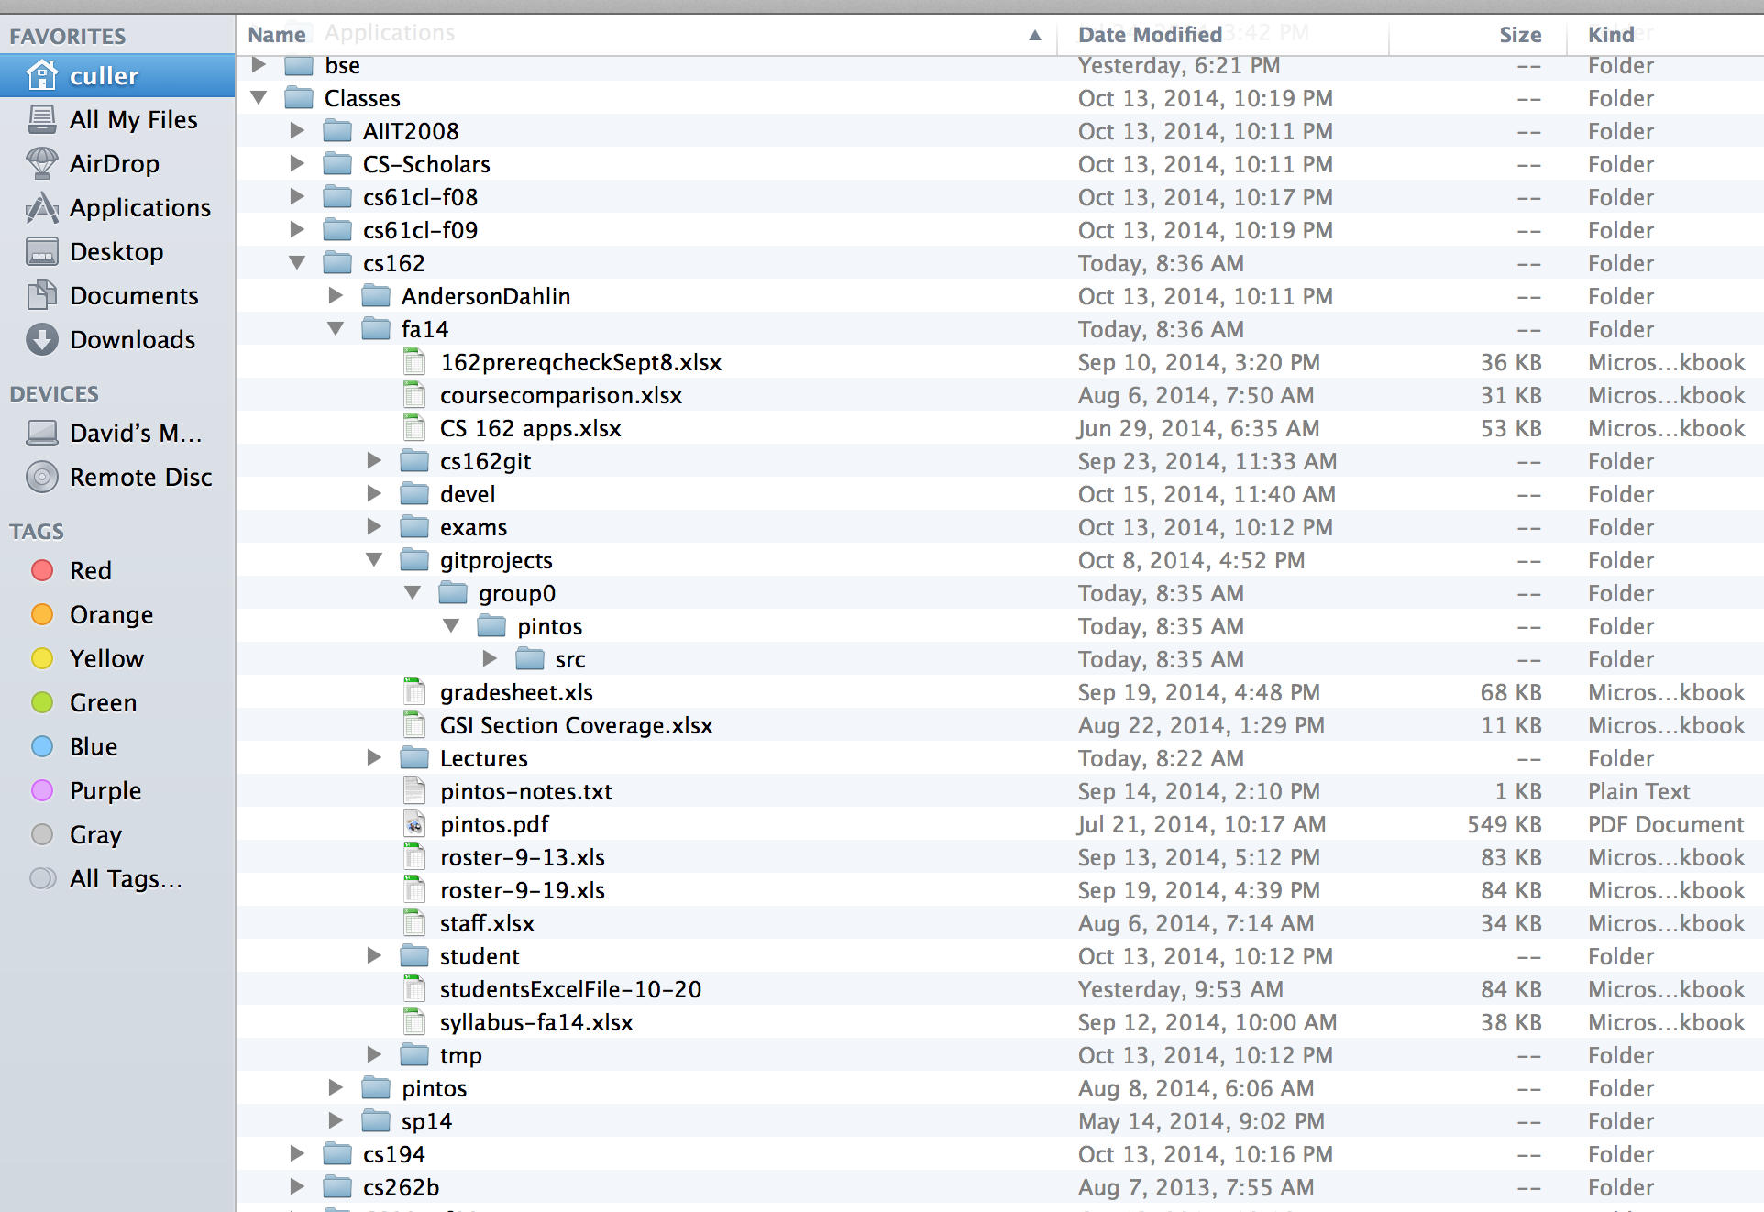
Directories

Slide 21
Directory
Basically a hierarchical structure
Each directory entry is a collection of
Files
Directories
A link to another entries
Each has a name and attributes
Files have data
Links (hard links) make it a DAG, not just a tree
Softlinks (aliases) are another name for an entry

Slide 22
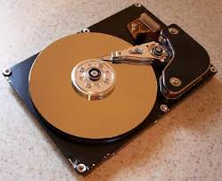
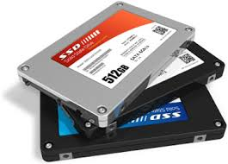

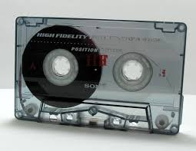
I/O & Storage Layers
Application / Service
streams
High Level I/O
Low Level I/O
handles
#4 - handle
Syscall
registers
File System
descriptors
I/O Driver
Commands and Data Transfers
Data blocks
Disks, Flash, Controllers, DMA
…
Directory Structure

Slide 23
File
Named permanent storage
Contains
Data
Blocks on disk somewhere
Metadata (Attributes)
Owner, size, last opened, …
Access rights
R, W, X
Owner, Group, Other (in Unix systems)
Access control list in Windows system
Data blocks
File handle
…
File descriptor
Fileobject (inode)
Position

Slide 24
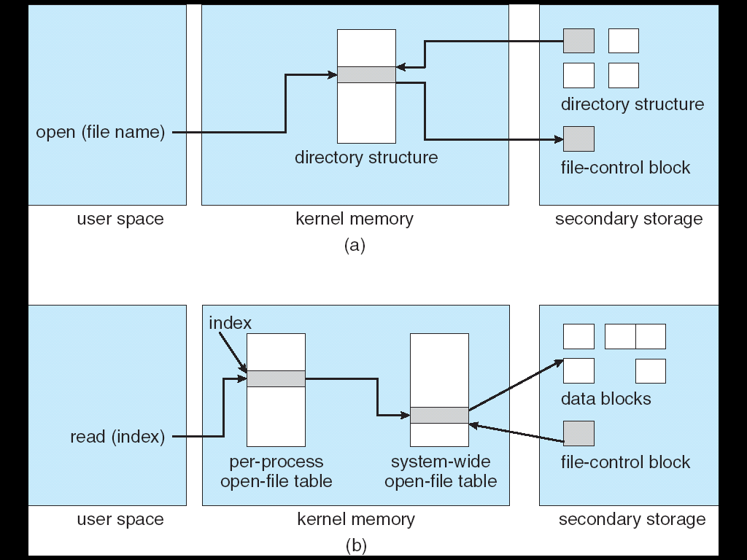
In-Memory File System Structures
Open system call:
Resolves file name, finds file control block (inode)
Makes entries in per-process and system-wide tables
Returns index (called “file handle”) in open-file table

Slide 25
In-Memory File System Structures
Read/write system calls:
Use file handle to locate inode
Perform appropriate reads or writes

Slide 26
break

Slide 27
Our first filesystem: FAT (File Allocation Table)
The most commonly used filesystem in the world!
Assume (for now) we have a way to translate a path to a “file number”
i.e., a directory structure
Disk Storage is a collection of Blocks
Just hold file data
Example: file_read 31, < 2, x >
Index into FAT with file number
Follow linked list to block
Read the block from disk into memory
FAT
Disk Blocks
file number
0:
0:
31:
File 31, Block 0
File 31, Block 1
File 31, Block 2
N-1:
N-1:
mem

Slide 28
FAT Properties
File is collection of disk blocks
FAT is linked list 1-1 with blocks
File Number is index of root of block list for the file
File offset (o = B:x )
Follow list to get block #
Unused blocks ⬄ FAT free list
FAT
Disk Blocks
file number
0:
0:
31:
File 31, Block 0
File 31, Block 1
free
File 31, Block 2
N-1:
N-1:
mem

Slide 29
FAT Properties
File is collection of disk blocks
FAT is linked list 1-1 with blocks
File Number is index of root of block list for the file
File offset (o = B:x )
Follow list to get block #
Unused blocks ⬄ FAT free list
Ex: file_write(51, <3, y> )
Grab blocks from free list
Linking them into file
FAT
Disk Blocks
file number
0:
0:
31:
File 31, Block 0
File 31, Block 1
File 31, Block 3
free
File 31, Block 2
N-1:
N-1:
mem

Slide 30
FAT Properties
File is collection of disk blocks
FAT is linked list 1-1 with blocks
File Number is index of root of block list for the file
Grow file by allocating free blocks and linking them in
Ex: Create file, write, write
FAT
Disk Blocks
file number
0:
0:
31:
File 31, Block 0
File 31, Block 1
File 63, Block 1
File 31, Block 3
free
63:
File 63, Block 0
File 2 number
File 31, Block 2
N-1:
N-1:
mem

Slide 31
FAT Assessment
FAT32 (32 instead of 12 bits) used in Windows, USB drives, SD cards, …
Where is FAT stored?
On Disk, restore on boot, copy in memory
What happens when you format a disk?
Zero the blocks, link up the FAT free-list
Simple
FAT
Disk Blocks
file number
0:
0:
31:
File 31, Block 0
File 31, Block 1
File 63, Block 1
File 31, Block 3
free
63:
File 63, Block 0
File 2 number
File 31, Block 2
N-1:
N-1:
mem

Slide 32
FAT Assessment
Time to find block (large files) ??
Block layout for file ???
Sequential Access ???
Random Access ???
Fragmentation ???
Small files ???
Big files ???
FAT
Disk Blocks
file number
0:
0:
31:
File 31, Block 0
File 31, Block 1
File 63, Block 1
File 31, Block 3
free
63:
File 63, Block 0
File 2 number
File 31, Block 2
N-1:
N-1:
mem

Slide 33
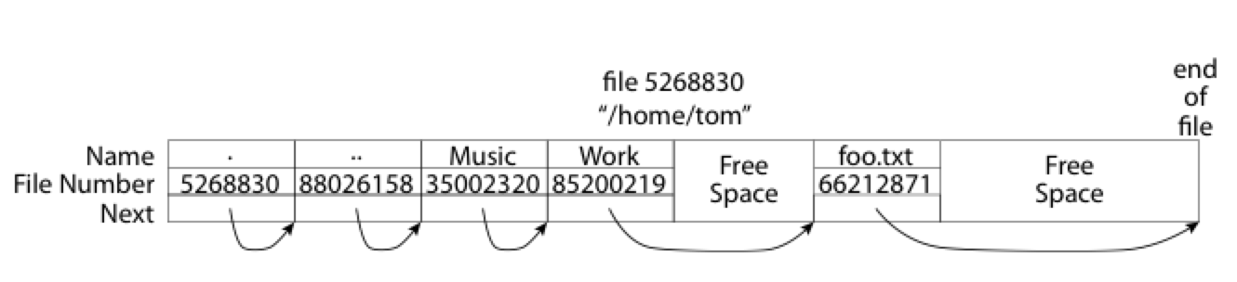
What about the Directory?
Essentially a file containing <file_name: file_number> mappings
Free space for new entries
In FAT: attributes kept in directory (!!!)
Each directory a linked list of entries
Where do you find root directory ( “/” )?

Slide 34
Directory Structure (cont’d)
How many disk accesses to resolve “/my/book/count”?
Read in file header for root (fixed spot on disk)
Read in first data block for root
Table of file name/index pairs. Search linearly – ok since directories typically very small
Read in file header for “my”
Read in first data block for “my”; search for “book”
Read in file header for “book”
Read in first data block for “book”; search for “count”
Read in file header for “count”
Current working directory: Per-address-space pointer to a directory (inode) used for resolving file names
Allows user to specify relative filename instead of absolute path (say CWD=“/my/book” can resolve “count”)

Slide 35
Many Huge FAT Security Holes!
FAT has no access rights
FAT has no header in the file blocks
Just gives an index into the FAT
(file number = block number)

Slide 36
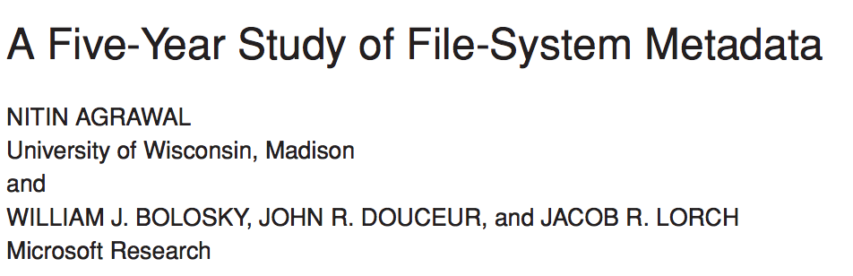
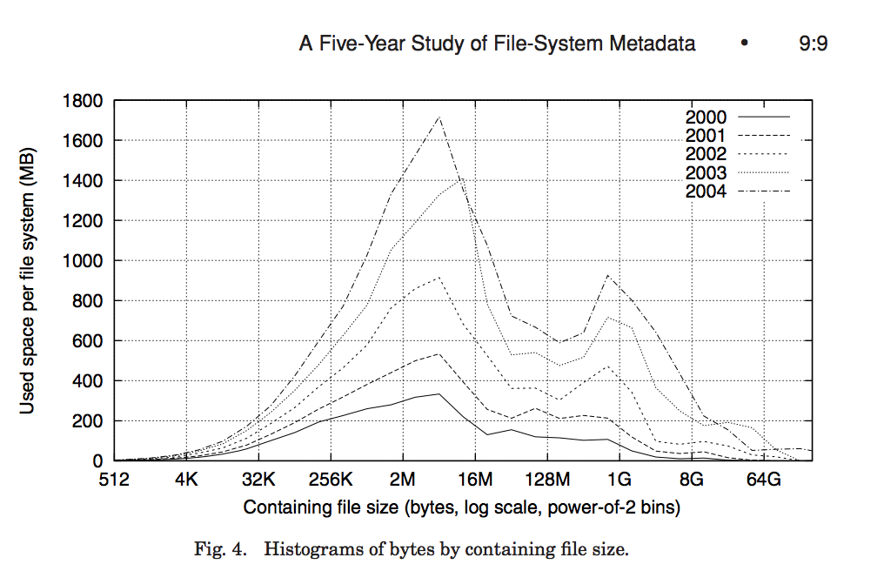
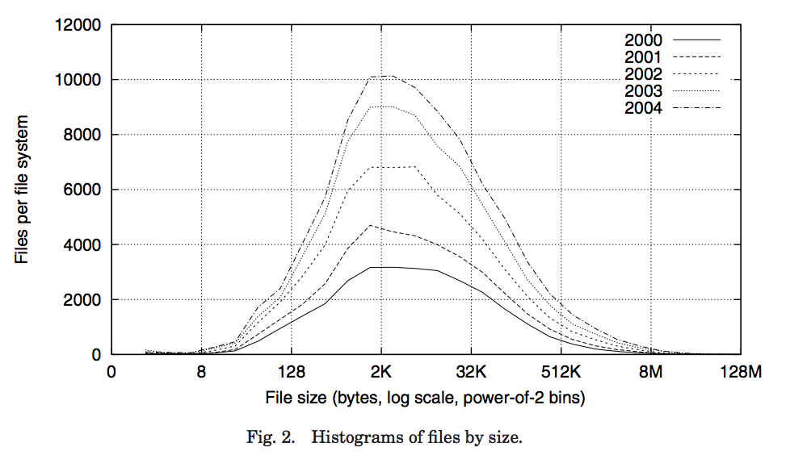
Characteristics of Files
Most files are small
Most of the space is occupied by the rare big ones

Slide 37
So What About a “Real” File System?
Meet the inode:
file_number

Slide 38
Summary
File System:
Transforms blocks into Files and Directories
Optimize for access and usage patterns
Maximize sequential access, allow efficient random access
File (and directory) defined by header, called “inode”
File Allocation Table (FAT) Scheme
Linked-list approach
Very widely used: Cameras, USB drives, SD cards
Simple to implement, but poor performance

Slide 39
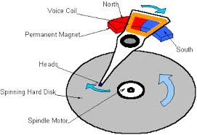
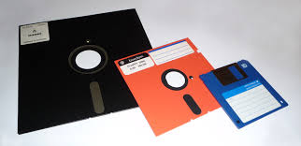
I/O & Storage Layers
Operations, Entities and Interface
Application / Service
streams
High Level I/O
Low Level I/O
handles
Syscall
registers
file_open, file_read, … on struct file * & void *
File System
descriptors
we are here …
I/O Driver
Commands and Data Transfers
Disks, Flash, Controllers, DMA

Slide 40
Recall: C Low level I/O
Operations on File Descriptors – as OS object representing the state of a file
User has a “handle” on the descriptor
#include <fcntl.h>
#include <unistd.h>
#include <sys/types.h>
int open (const char *filename, int flags [, mode_t mode])
int creat (const char *filename, mode_t mode)
int close (int filedes)
Bit vector of:
Access modes (Rd, Wr, …)
Open Flags (Create, …)
Operating modes (Appends, …)
Bit vector of Permission Bits:
User|Group|Other X R|W|X
http://www.gnu.org/software/libc/manual/html_node/Opening-and-Closing-Files.html

Slide 41
Recall: C Low Level Operations
ssize_t read (int filedes, void *buffer, size_t maxsize)
- returns bytes read, 0 => EOF, -1 => error
ssize_t write (int filedes, const void *buffer, size_t size)
- returns bytes written
off_t lseek (int filedes, off_t offset, int whence)
int fsync (int fildes) – wait for i/o to finish
void sync (void) – wait for ALL to finish
When write returns, data is on its way to disk and can be read, but it may not actually be permanent!

